Slide 1
Molecular Biology Biol 480
Lecture 28 April 8th , 2019

Slide 2
Announcements/Assignments
Lab journals will be graded for a “final grade” of an additional 10 possible points for completeness and usefulness as a lab journal. (Please don’t just tape/fold in all the handouts).
Cool article on 5 important types of RNA. One relevant as we just talked about mobile elements called SINEs
Please read

Slide 3
Where were we?...Gene expression regulation
Most gene products (RNAs and proteins) are not needed in large quantities all the time.
Cells with different functions produce unique subsets of RNAs and proteins.
Therefore, cells must have mechanisms for regulated gee

Slide 4
For example…
In positive control---transcription occurs only if a regulator directly stimulates transcription.
In negative control—transcription occurs unless it is shut off by a regulator molecule.
**Lactose metabolism enzymes are regulated with both negative an positive control systems.

Slide 5
Let’s examine the Lactose (lac) operon
Recall prokaryotes have some of their genes in clusters, called operons. Operons encode polycistronic mRNA which encodes more than one protein. Operons encode several proteins which are needed for a common purpose.
The lac operon encodes 3 enzymes needed for bacteria to utilize lactose for energy.
See figure 16-1—but know the missing detail

Slide 6
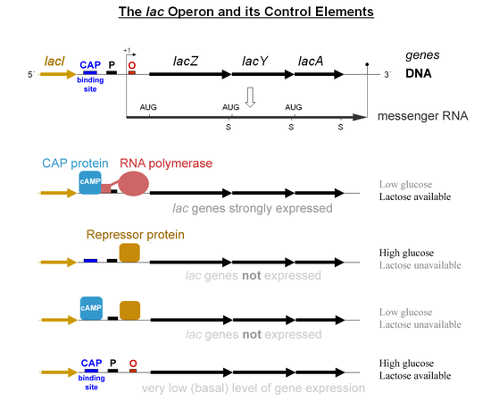

Slide 7
lac Z, lacY, and lacA encode the 3 structural genes encoding proteins needed for lactose metabolism.
Read about the function of each protein in lactose metabolism.
Upstream of the structural genes are regulatory sequences, called the promoter, the operator, and the activator/CAP binding site.

Slide 9
Upstream of the regulatory region is a gene that encodes a repressor (a protein) of the whole system.
The gene is labeled “I”. I encodes a protein, but the repressor protein is not needed to metabolize lactose. It is not one of the operon’s structural genes. It’s role is in regulation.

Slide 11
Let’s summarize the main details of the operation of the lac operon…then return to how we came to know these details.
First…bacteria normally utilize glucose (not lactose) using a set of enzymes other than lacZ, lacY, and lacA.
So most of the time it would be wasteful to make the lac proteins. They are usually repressed by the I protein.

Slide 12
I binds to a site within the regulatory region called the operator (O). O is close to the start site of transcription of the structural genes and physically blocks the ability of RNA polymerase to bind and begin transcription.
…Review…which parts of this system are cis-elements? Which parts are trans elements?

Slide 14
When lactose is present (and glucose is not) bacteria need to make lac Z, Y, and A.
Lactose de-represses/induces the system by binding to lac I, ,making Lac I unable to bind to O.
This allows RNApol to bind to the promoter and to slide to the +1 site to begin transcription.

Slide 16
You’ve likely noticed that there are other players in the regulation of lactose. A protein that is involved in regulation of several operons, called Catabolite Activating Protein (CAP) exerts positive control on the lac operon.
RNAP is actually fairly inefficient in binding the promoter---CAP greatly increases its efficiency.

Slide 17
CAP’s shape and function is dependent on another molecule, a nucleotide called cyclic AMP (cAMP). …recall how some nucleotides function outside of nucleic acids?...
cAMP levels are regulated by glucose!
High glucose levels----low cAMP
Low glucose levels---high cAMP

Slide 18
Let’s look at the whole picture----the elegant system used by bacteria to make sure they can use available nutrients (to make energy) without wasting energy!
There is only one situation in which the lac operon should be transcribed.

Slide 23
Step through this tutorial…
Not an animation, but an excellent dialog and illustration by Jacques Monod and Francois Jacob.
The first scientists to really explain how genes can be turned on and off.
http://www.dnalc.org/view/16688-Animation-33-Genes-can-be-turned-on-and-off-.html

Slide 24
How on earth were the details of this system discovered? Mutants of course! Nearly everything we know about biological systems comes from noticing organisms with variation.
Some bacteria cannot metabolize lactose properly---they have mutations in lac genes or lac regulatory sequences.

Slide 25
The system can be tested! The system can also be manipulated if we have certain predictions.
1. The regulatory sequences are cis—they are part of the DNA AND they must be positioned physically close to the structural genes. (WHY?)
2. Cis elements do not encode a protein product---but proteins can be added to the system from another source. (your book calls these addible products diffusible.)

Slide 26
The trans elements are diffusible…in fact, this is the ultimate test for a trans element. You can add the protein product to the system. If you think about it, the I gene need not be physically close to the structural genes. As long as the protein is present in the system, the system should be repressed.

Slide 27
Mutants have been identified that have constitutive expression of Lac Z,Y, and A.
In these bacteria, the system is never repressed, and lactose does not induce.
What could the problem be? Could more than one possible type of mutant show this mutant phenotype?

Slide 28
Propose a hypothesis…
This mutant has a problem with it’s cis elements.
(Which part of the cis elements is likely mutated?)

Slide 29
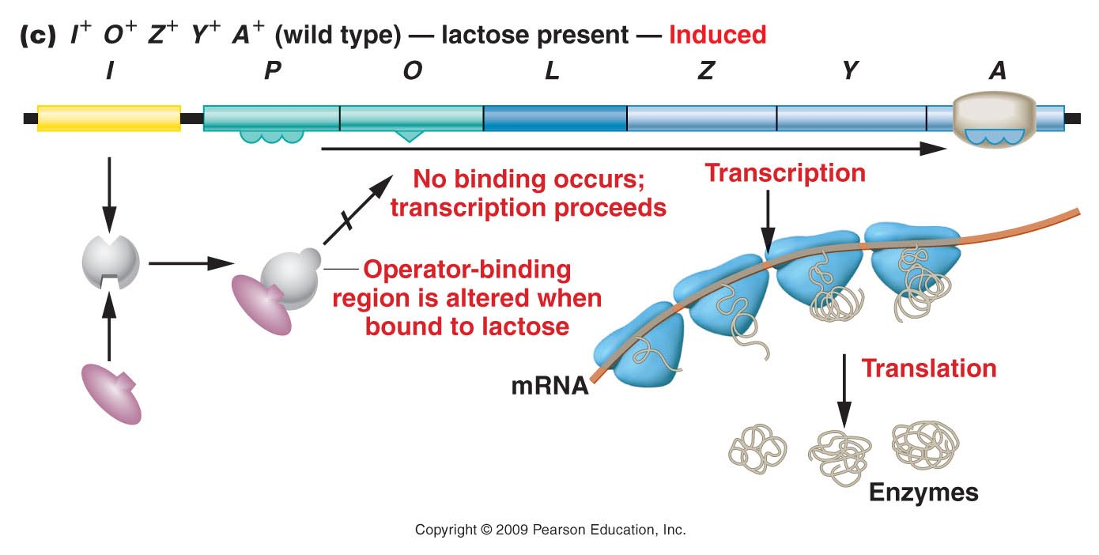
Figure 17.5c
Notes:
Figure 17-5c The components of the wild-type lac operon and the response in the absence and the presence of lactose.

Slide 30
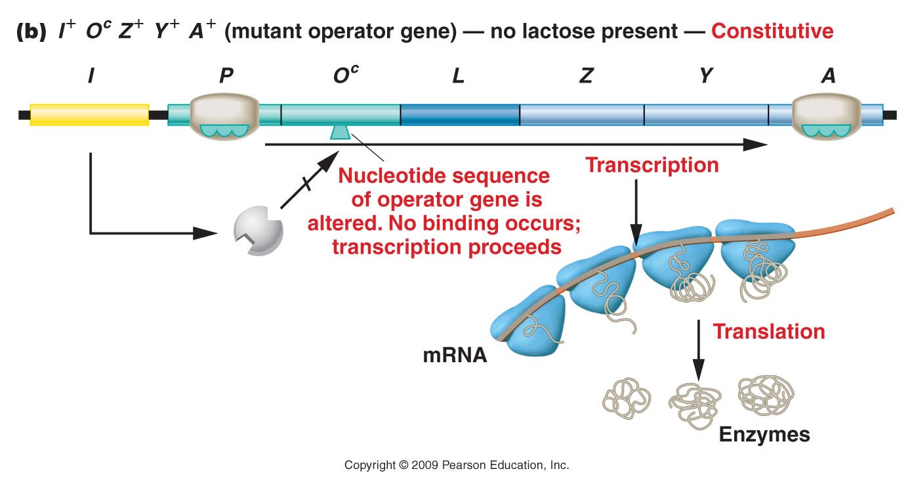
Figure 17.6b
Notes:
Figure 17-6b The response of the lac operon in the absence of lactose when a cell bears either the or the mutation.

Slide 31
Learn the symbolic designations
I⁺O⁺Z⁺ (Y⁺ A⁺) is fully wild type.
If the mutant is predicted to have a constitutive mutation in the cis elements, it would likely be in the O region.
I⁺O^{c}Z⁺ tells us that there is a mutation in O that makes expression of lac Z constitutive.

Slide 32
As you know-- in bacteria we can do experiments to add DNA/genes and look for expression of the genes or changes in phenotype.
In nature, bacteria can transfer a special plasmid called the F’ plasmid. Any bacterium with the F’ plasmid can express other genes on it, AND pass the F’ plasmid to its progeny.
(see chapter 6 for general review)

Slide 33
The F’ plasmid does not insert itself into the bacterial chromosome---it does not become physically linked to the Lac operon structural genes.
Why do we care….?

Slide 34
What would you expect if you added the F’plasmid with a wild-type O region to a bacterium with I⁺O^{c}Z⁺ phenotype?
Would lacZ be repressed? Would it restore its inducibility? Why or Why not?

Slide 35
Let’s return to a constitutive mutant…are their other hypotheses for the defect?
Could it involve a trans element? If so, which one?
How would you designate it using our genotype symbols?

Slide 36
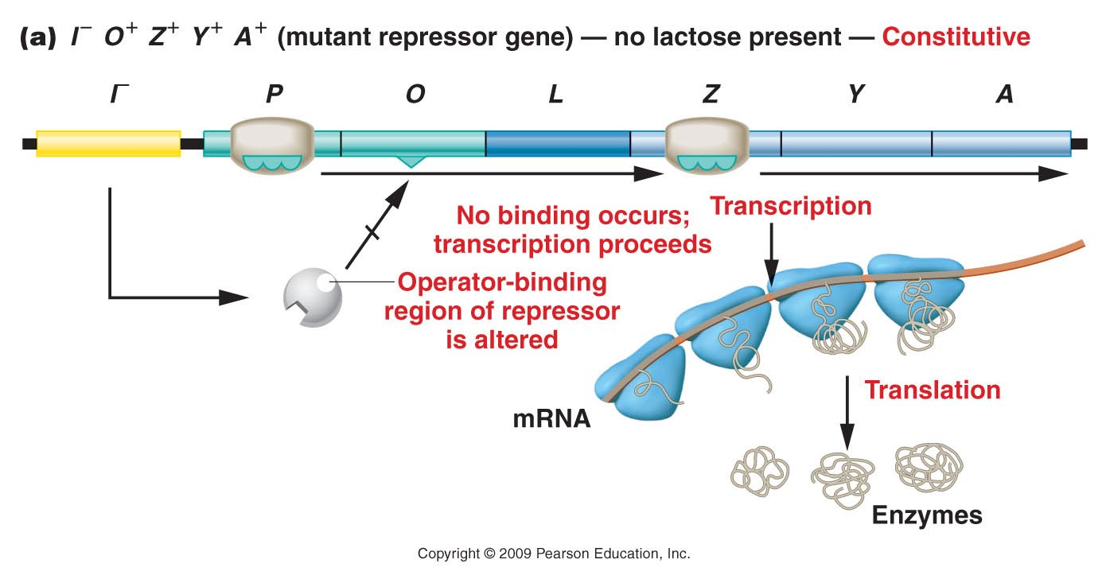
Figure 17.6a
Notes:
Figure 17-6a The response of the lac operon in the absence of lactose when a cell bears either the or the mutation.

Slide 37
Using the F’ plasmid, could you “fix” the
I⁻O⁺Z⁺ mutation?

Slide 38
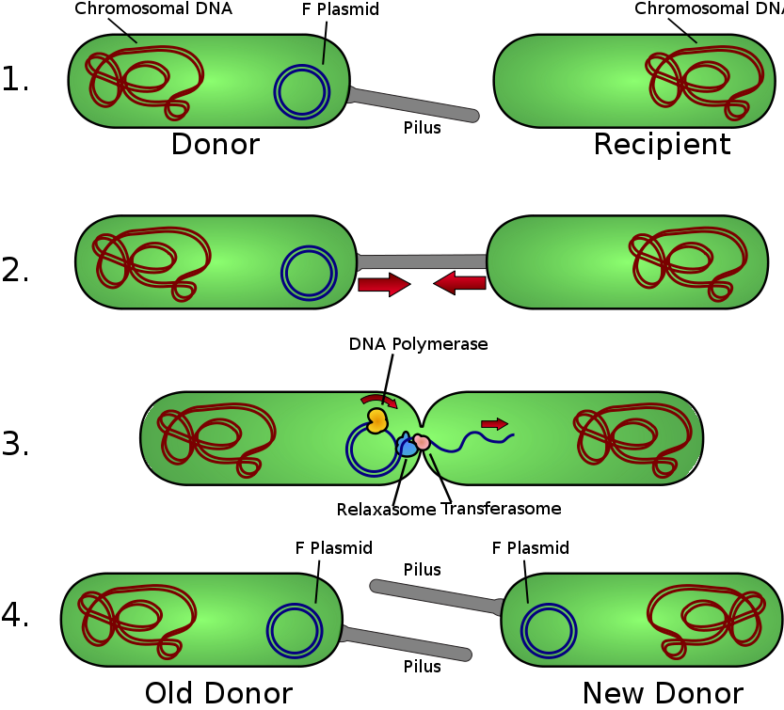
What if the F’ plasmid was constructed to have a wild type I gene?

Slide 39
Mutations in trans elements can be fixed by addition of a wild type gene or by any means of getting that diffusible element into the system!

Slide 40
Summarize
Generally describe 2 types of constitutive mutants for the lac operon.
Design experiments to distinguish the type of problem that makes each mutant constitutive.
Explain the outcome of your experiements.

Slide 41
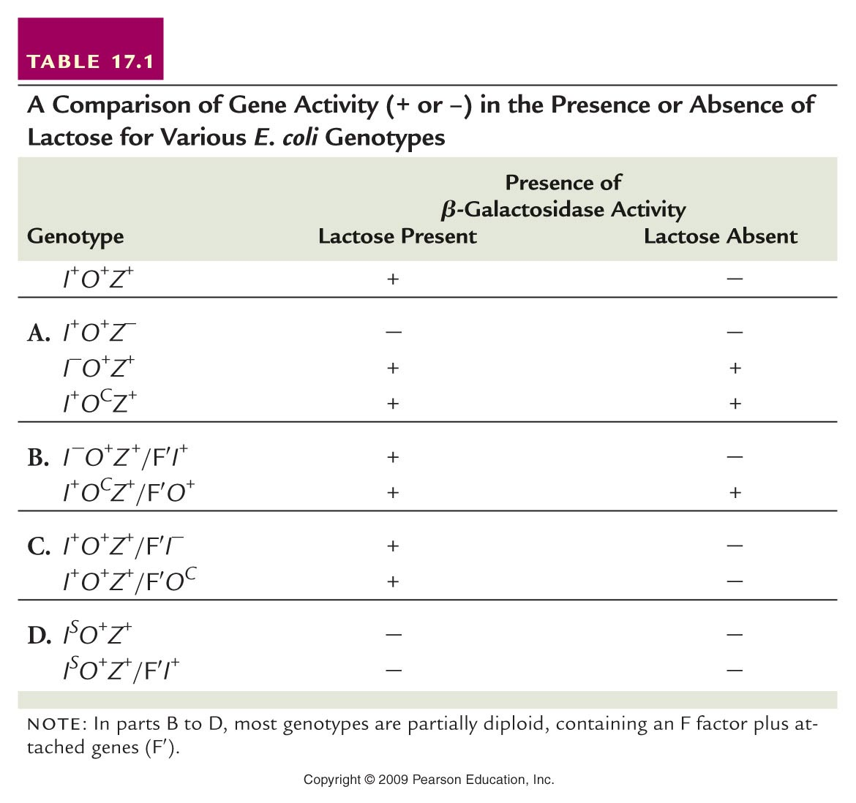
Read more! Dissect table 16.1

Slide 42
Spend time on this. Quiz yourself or class mates. Practice.

